Slide 1
Burnt calories
numerical dataset

Slide 2
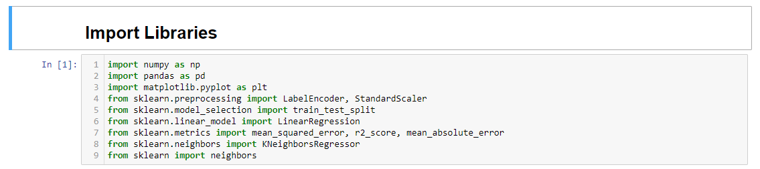
LIBRARIES
numpy (as np): Numerical operations and array manipulations.
pandas (as pd): Loading and manipulating datasets.
math (import sqrt): Calculating square root (used for calculating RMSE).
matplotlib.pyplot (as plt): Plotting graphs and visualizations.
sklearn.preprocessing: Label encoding and standard scaling.
sklearn.model_selection: Splitting the dataset into training and testing sets.
sklearn.linear_model: Implementing and training a Linear Regression model.
sklearn.metrics: Calculating regression evaluation metrics.
sklearn.neighbors (import KNeighborsRegressor): Implementing and training a K-Nearest Neighbors regression model.
sklearn (import neighbors): Used in conjunction with KNeighborsRegressor.

Slide 3
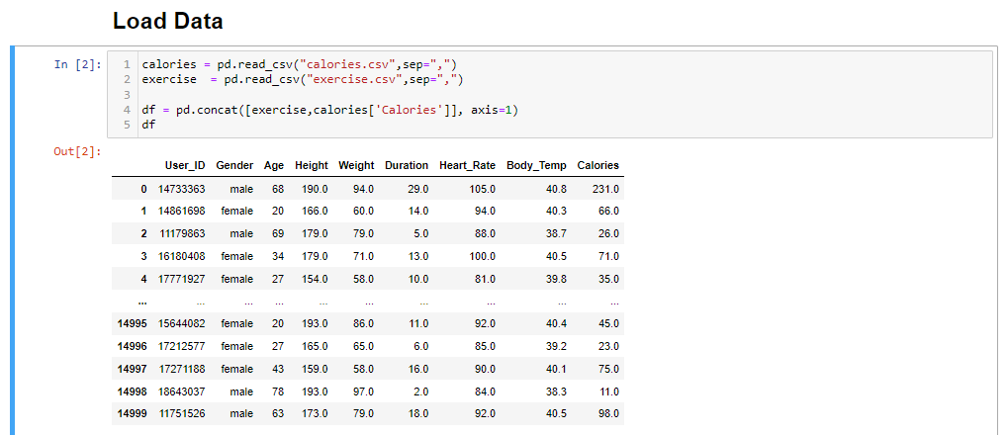
Reading two datasets, "calories.csv" and "exercise.csv," and then concatenating them along the columns to create a new DataFrame named df.

Slide 4
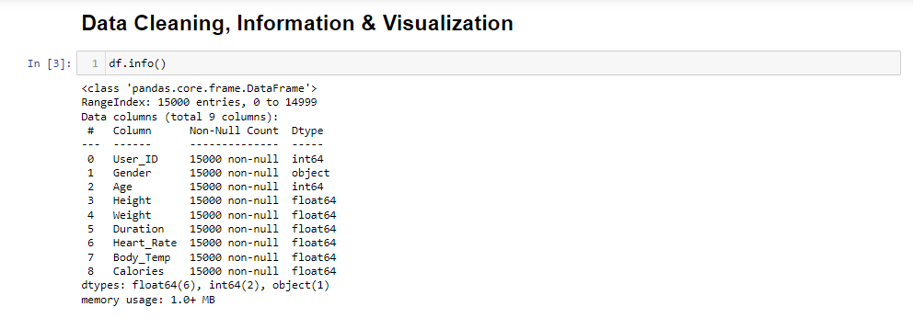
summary of the DataFrame df, including information about the data types, non-null values, and memory usage.

Slide 5
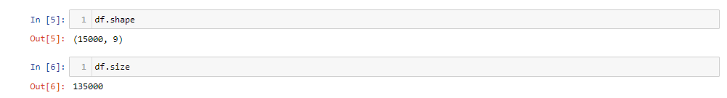
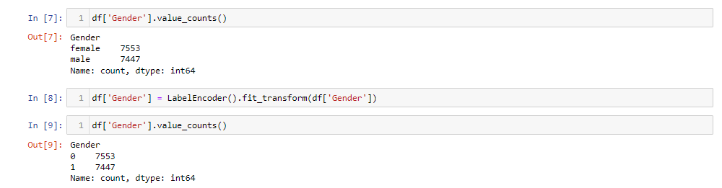
The dimensions of the DataFrame df .
Get the count of unique values in the 'Gender' column of the DataFrame df, and then using LabelEncoder() to transform the 'Gender' column into numerical values.

Slide 6
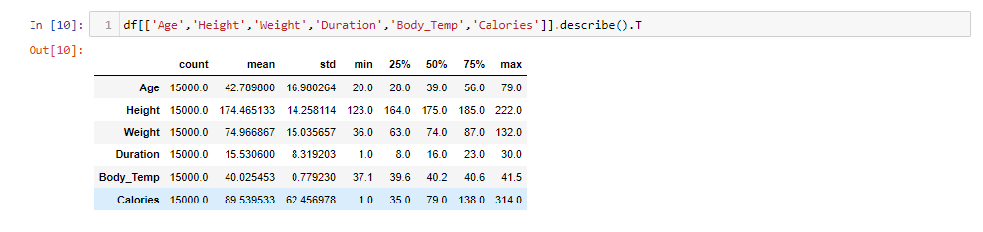
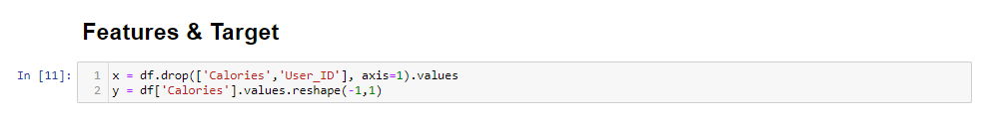
Summary of statistics for each numeric column in the DataFrame.
Creates a new DataFrame x by dropping the columns ‘Calories’ and ‘User_ID’ from the original DataFrame (df).
The .values attribute is then used to convert the DataFrame into a NumPy array.
Extracts the target variable 'Calories' from the original DataFrame (df) in a new DataFrame y.
The .reshape(-1, 1) to transform y into a column vector.

Slide 7
Split the features (x) and target variable (y) into training and testing sets.
The test_size parameter specifies the proportion of the dataset to include in the test split (20% for testing).

Slide 8
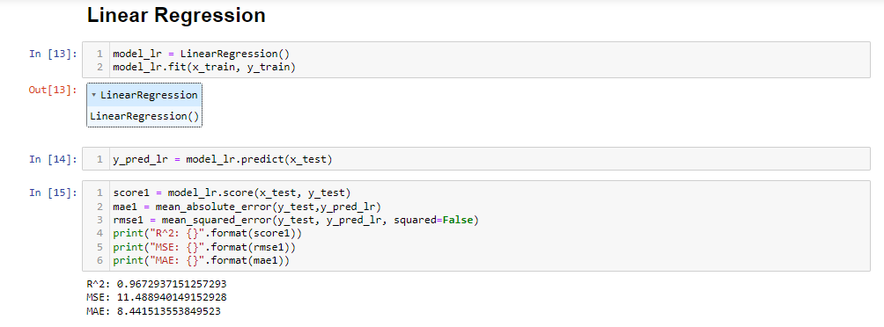
Train the Linear Regression model on the training data (x_train, y_train).
Generate predictions (y_pred_lr) on the testing data (x_test) using the trained model.
Evaluation of how well the Linear Regression model is performing on the testing set.
Calculates the root mean squared error (RMSE) between the true target values and the predicted values.
Calculates the mean absolute error between the true target values (y_test) and the predicted values (y_pred_lr).

Slide 9
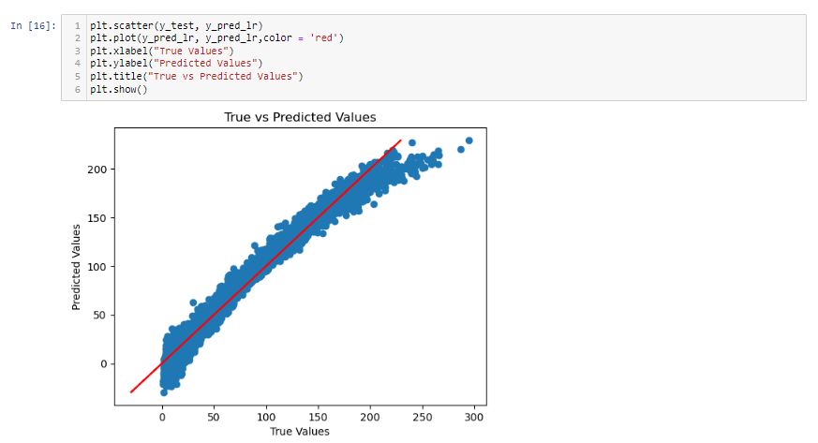
Line shows where the true values equal the predicted values.

Slide 10
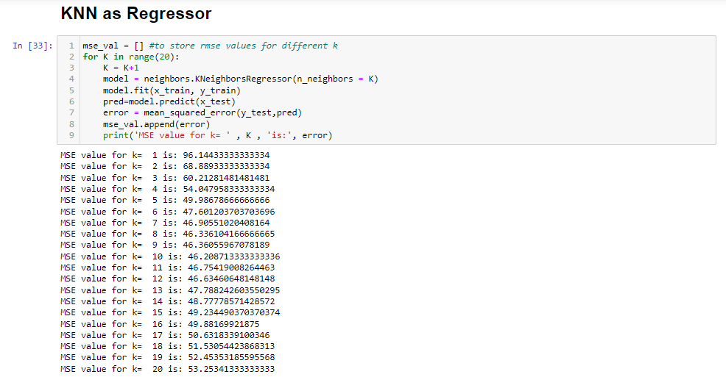
Loop over different values of K:
For each value of K from 1 to 20:
Create a KNN regression model (n_neighbors = K)).
Train the model using the training data (x_train, y_train).
Make predictions on the testing data (x_test).
Calculate the mean squared error between the true target values (y_test) and the predicted values (pred).
Append the error to the mse_val list.
Print the MSE value for the current K.
To determine the optimal value of K that gives the best performance on your dataset.

Slide 11
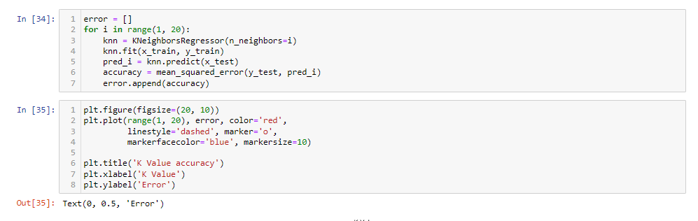
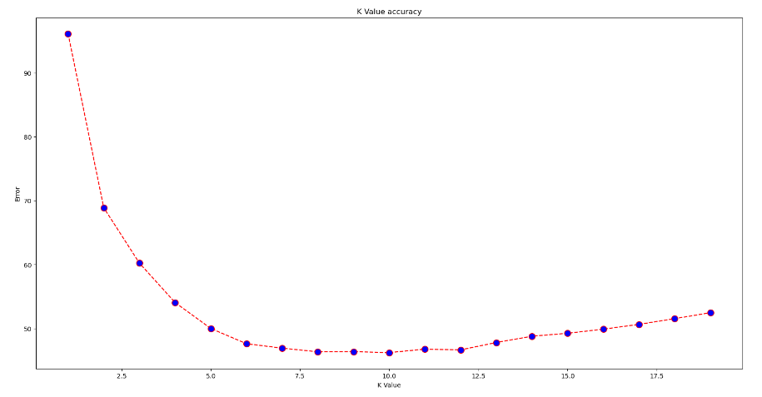
This plot allows to visualize how the error changes with different values of K, identifying the optimal K value for your KNN regression model.

Slide 12
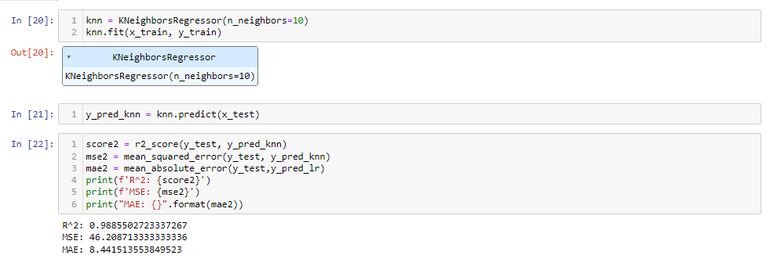
Evaluation of how well the KNN Regressor model is performing on the testing set.
Calculates the root mean squared error (RMSE) between the true target values and the predicted values.
Calculates the mean absolute error between the true target values (y_test) and the predicted values (y_pred_lr).

Slide 13
